Slide 1
Building for your Future Self
Marcelo Paiva and Claudio Luis Vera

Slide 2
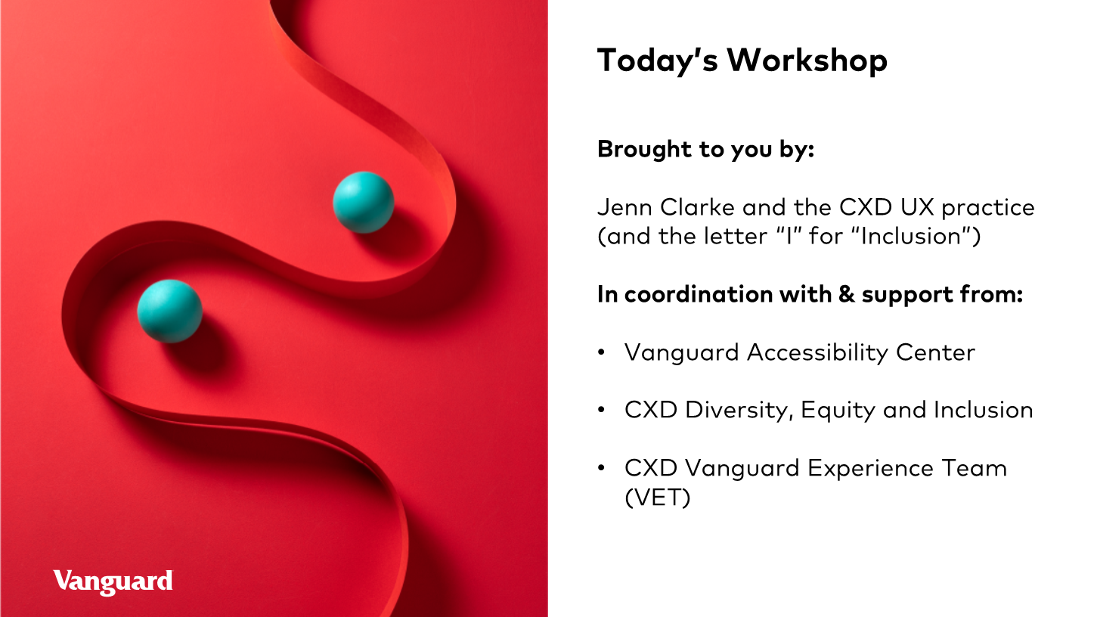

Slide 3
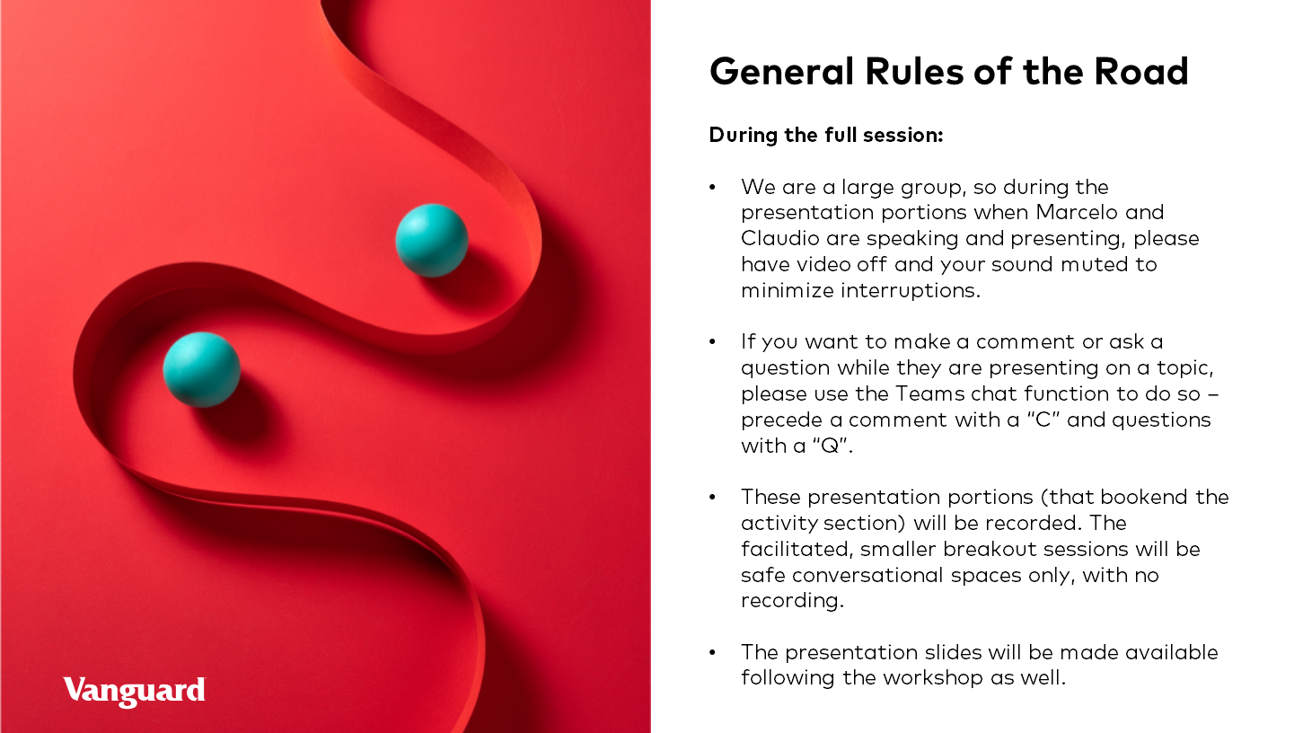

Slide 4
Safe and Inclusive
This is an inclusive and safe space to collaborate.

Slide 5
Q:
Do we have your permission to record this session?
Break out sessions and activities won't be recorded.

Slide 6
Building Your Future Self
Marcelo Paiva and Claudio Luis Vera - May 19, 2021

Slide 7
Roles that we’ve played
Organizations
Royal Caribbean
UKG
Sapient Global Markets (Publicis)
Fidelity Investments
Thomson Reuters
Barclays Capital
Franklin Templeton
Speaking Venues
Access+Equity
IXDA Interaction Design Association
UX India - 2016, 2020
Taylor Center for Social Innovation and Design Thinking - Tulane University
Inclusive Design - Unisinos University
UXperience Conference
DEVCON - Conference
UXDEV Conference 2016, 2017, 2018
Public Speakers
Community Organizers
A11y
Consultants
Inclusive Design Accessibility Leadership
Creative Directors
Design Management
UX
Design
Team Building
Increasing Disabilities
People Management
Educators
Aging humans
Frontend Development
Caregiver

Slide 8
Part 1:
The Role Of Design In Discrimination
Claudio Luis Vera
Notes:
(20-25 min)

Slide 9
Going Back In Time…

Slide 10
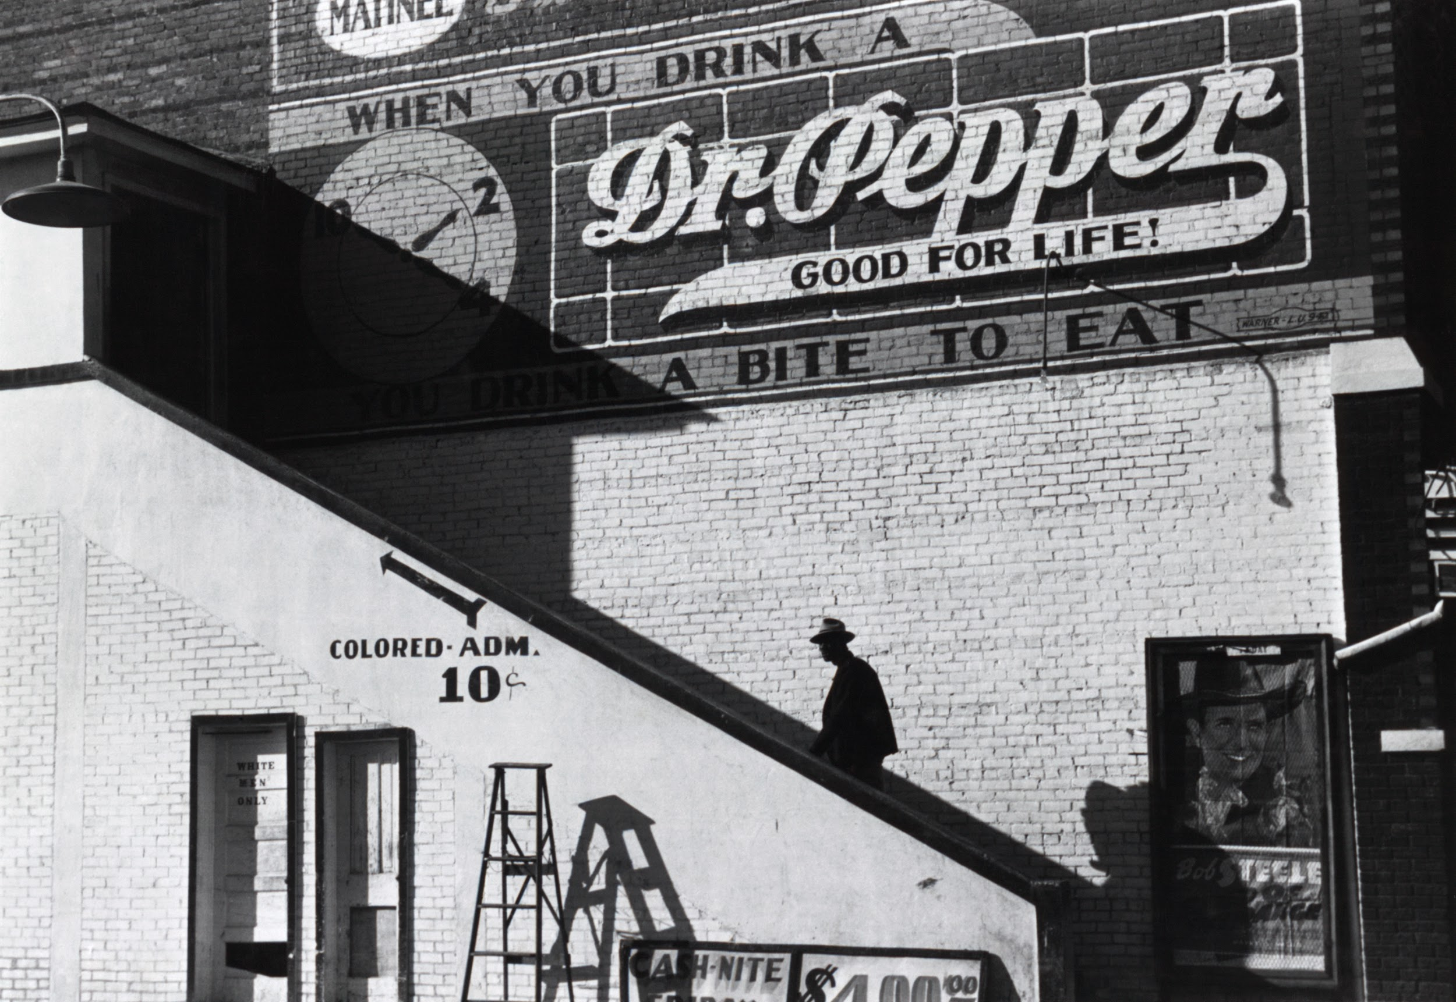
80 years ago
on a Saturday afternoon, at a movie house, in the Mississippi Delta

Slide 11
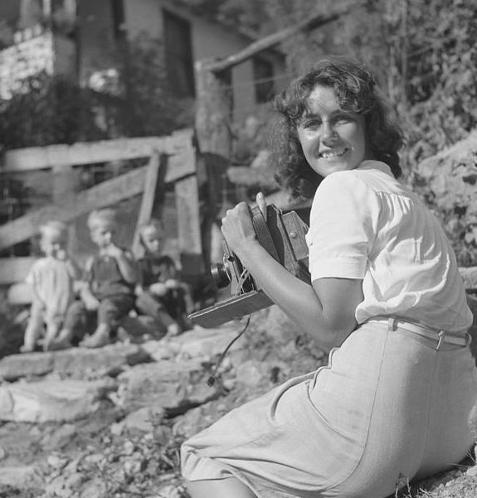

Marion Post Wolcott
29 years old, photographed the effects of rural poverty.

Slide 12
Racial segregation
was so common, it would have been overlooked

Slide 13
Corporate sponsorship
Today, this photo would have triggered boycotts and divestment

Slide 14
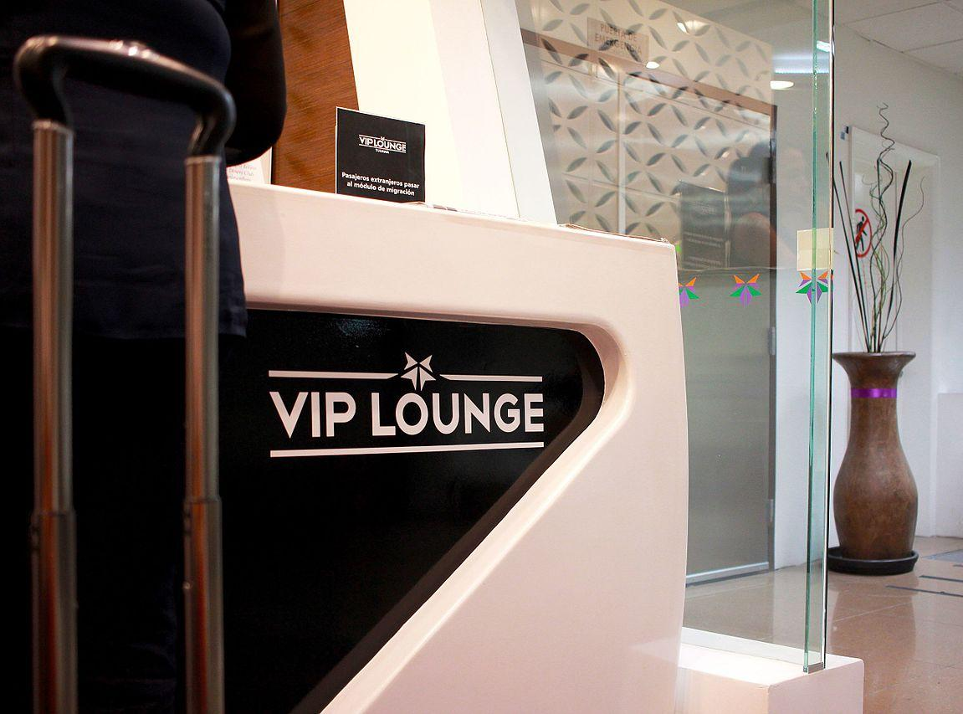
Jumping forward to today
Segregation based on ability to pay

Slide 15
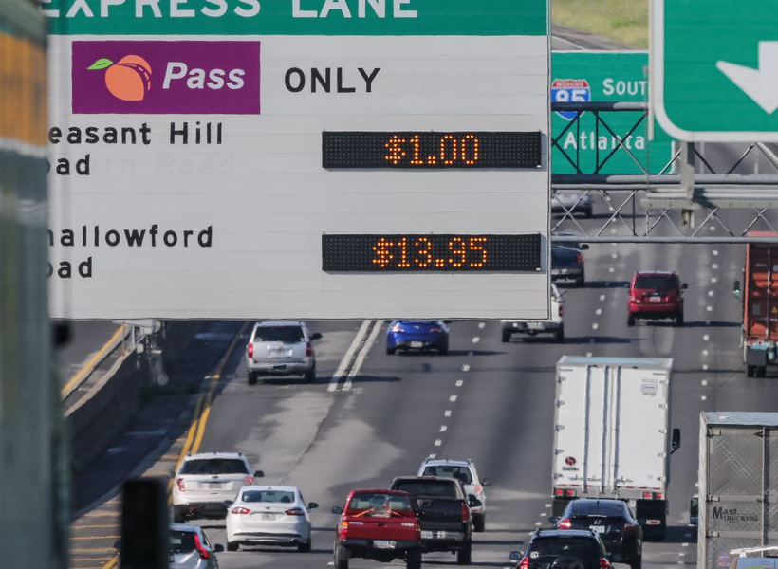
Two-class system
Those who pay and those who can’t

Slide 16
What’s the breaking point?
$139.50?
How does it feel to be unable to use it?
Notes:
what if the toll was $600?
what if there were 4 express lanes, and one slow lane?

Slide 17
Being marginalized
feeling that something is not designed for you
adj. (of a person, group, or concept) treated as insignificant or peripheral.
"members of a marginalized cultural group"

Slide 18
What Does Discrimination
Look Like?

Slide 19
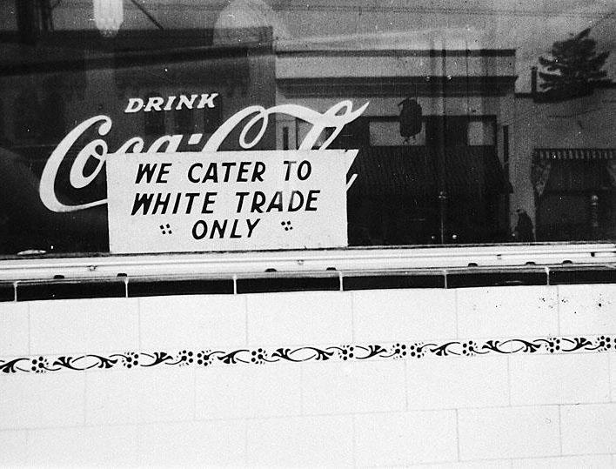
What it’s not.
ABLED
Today’s kind of discrimination is more subtle, but just as marginalizing.
Notes:
what it’s not.

Slide 20
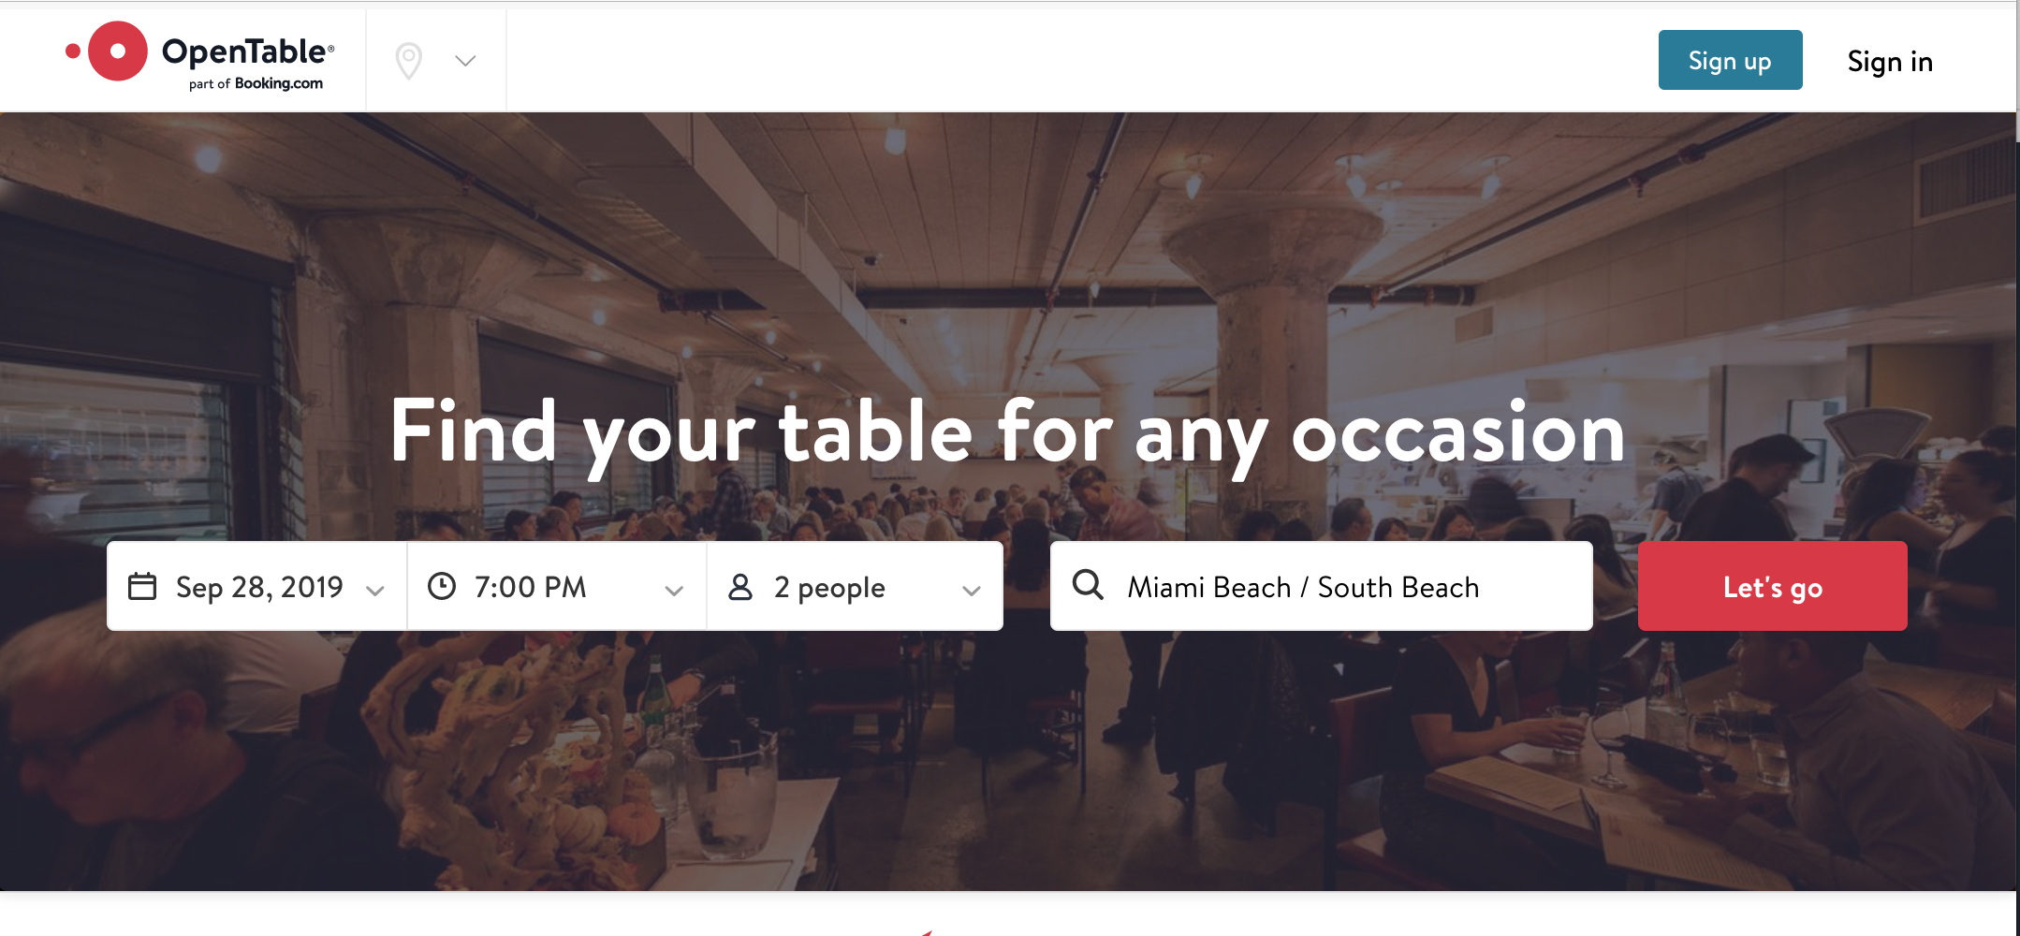
Today:
A restaurant reservation system that doesn’t work for blind people
Based on White v. Square lawsuit

Slide 21
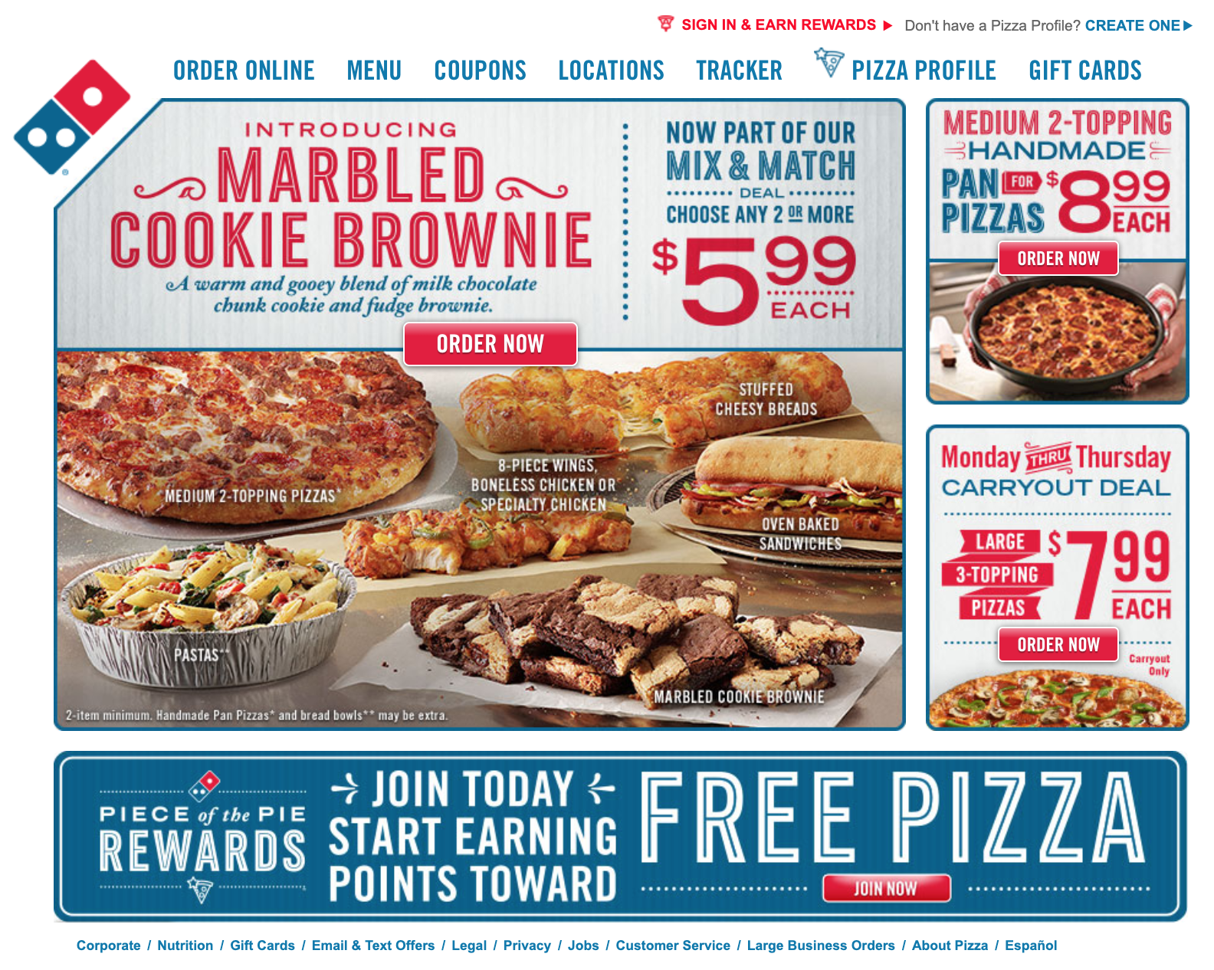
Dominos.com
A pizza site that doesn’t serve blind people
Based on Robles v. Dominos lawsuit

Slide 22
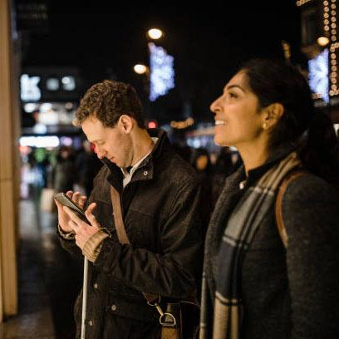
Today:
Blind/older people don’t use our app.
These are edge cases.
What does discrimination sound like?
Accessibility is not in our budget.
It’s not MVP
OK, Boomer

Slide 23
A Built-in Imbalance

Slide 24
Hierarchy of UX
EXCELLENCE
Will it win awards?
A
GREAT UX
Can we brag about it?
B
GOOD UX
Does it make sense?
C
UNDERSTANDABLE
Is it operable?
D
OPERABLE
Can you read the content?
F
PERCEIVABLE

Slide 25
Disparity in the real world
Award-winning experiences
EXCELLENCE
Will it win awards?
A
GREAT UX
Can we brag about it?
B
GOOD UX
Baseline
Does it make sense?
C
UNDERSTANDABLE
Is it operable?
WCAG Compliant
D
OPERABLE
Can you read the content?
F
98% of the web
PERCEIVABLE

Slide 26
Mismatches And Disabilities

Slide 27
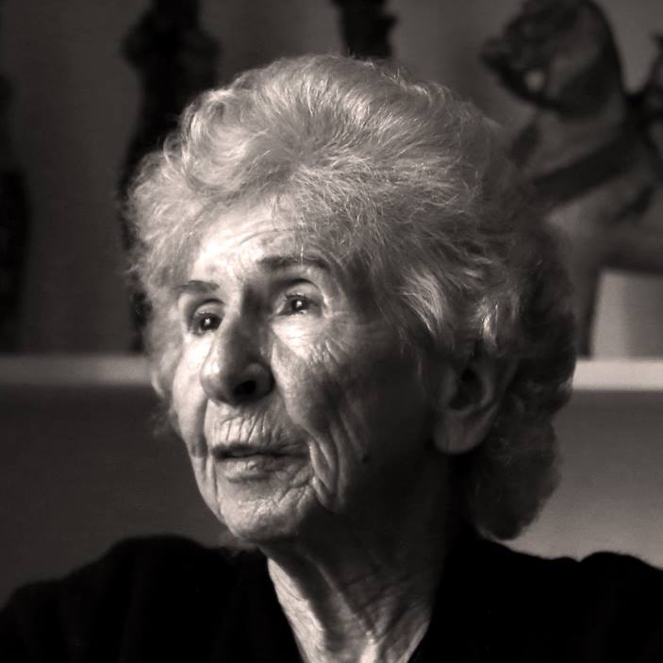
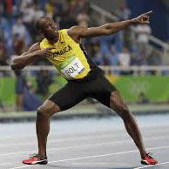
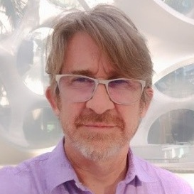
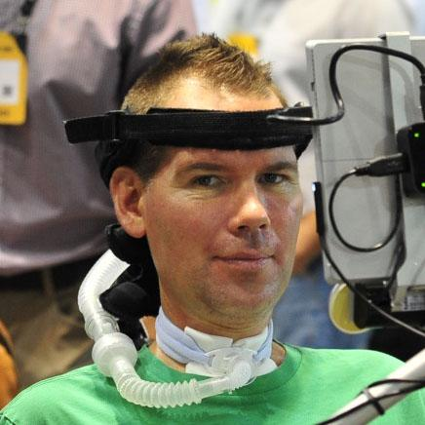
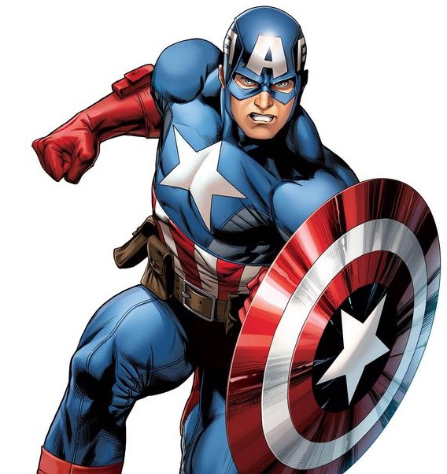
Spectrum of abilities
Usain Bolt
Superhero
My 93-year-old mother
Quadriplegic
Me

Slide 28
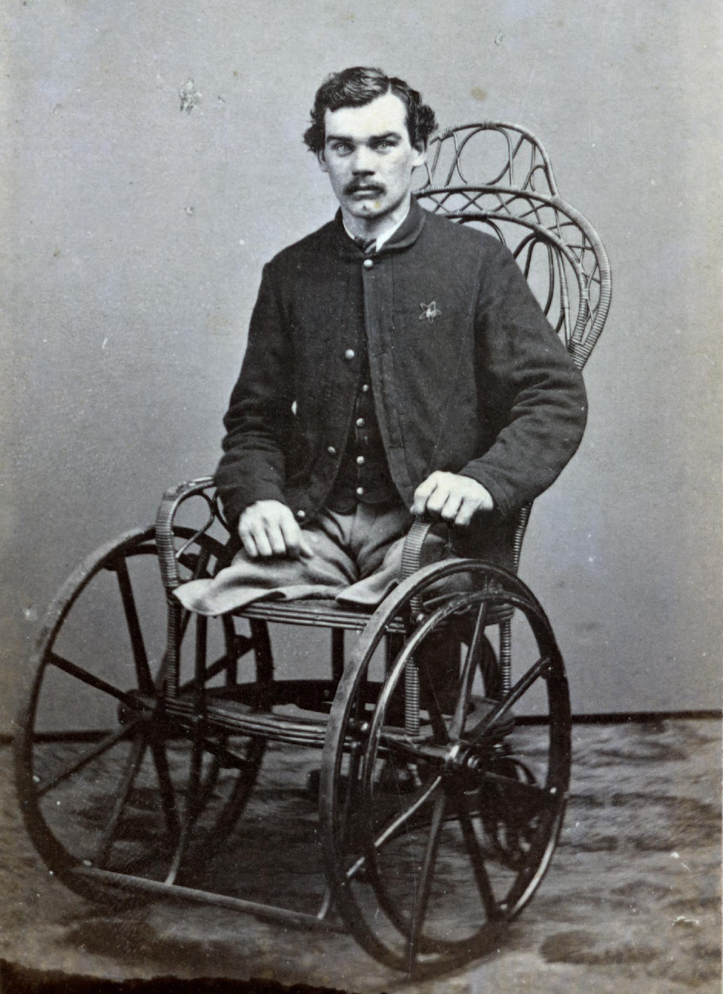
Our view of disability
Medical model
Highly visible conditions
Origins in the Reconstruction, when benefits were given to permanently disabled veterans of the Civil War
Charity model
People with disabilities are dependent and to be pitied.

Slide 29
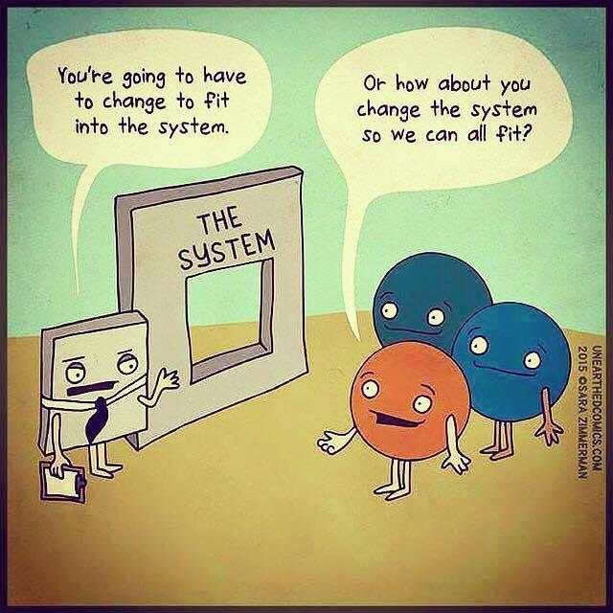
The social model of disability
The problem is not the impairment, it’s the barriers we create as a society.
We create and perpetuate our own disabilities.

Slide 30
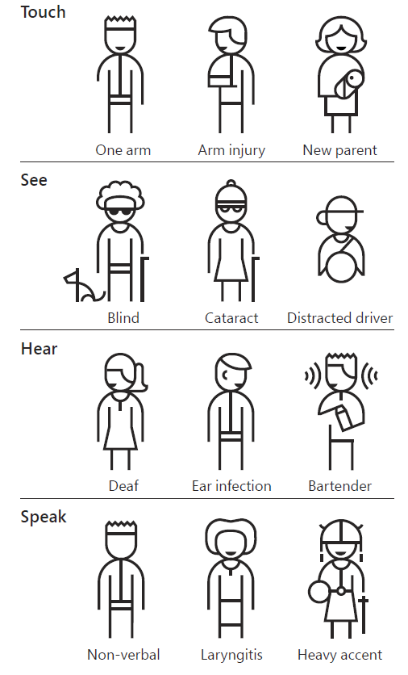
Not every impairment is permanent

Slide 31
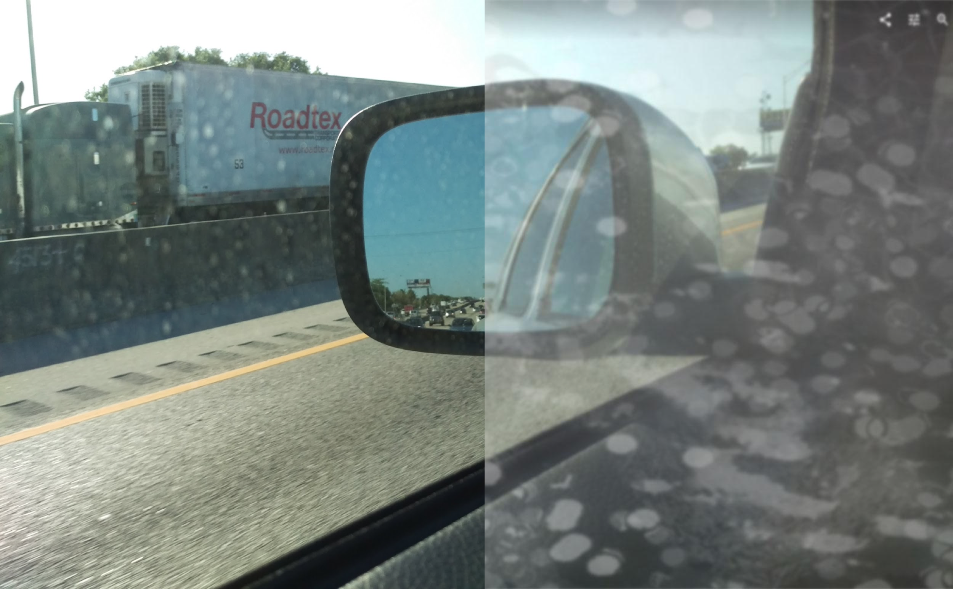
Dirty window
Cataracts

Slide 32


What is a disability?
Disability is not a personal health condition.
Disability is when your abilities aren’t up to the task at hand
Notes:
when there’s a mismatch between your abilities and the task at hand

Slide 33
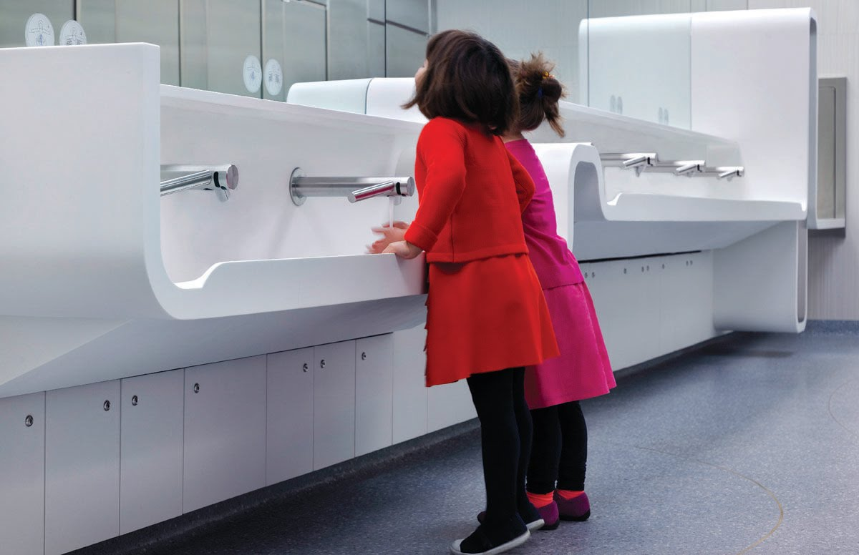
Built-in accessibility
Is as elegant as the rest of your design experience

Slide 34
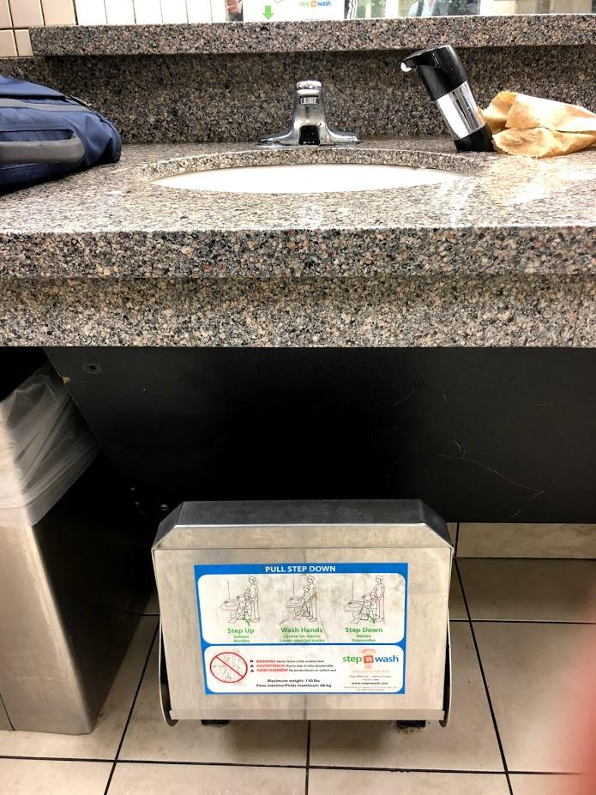
Bolt-on accessibility
Is added after the fact

Slide 35
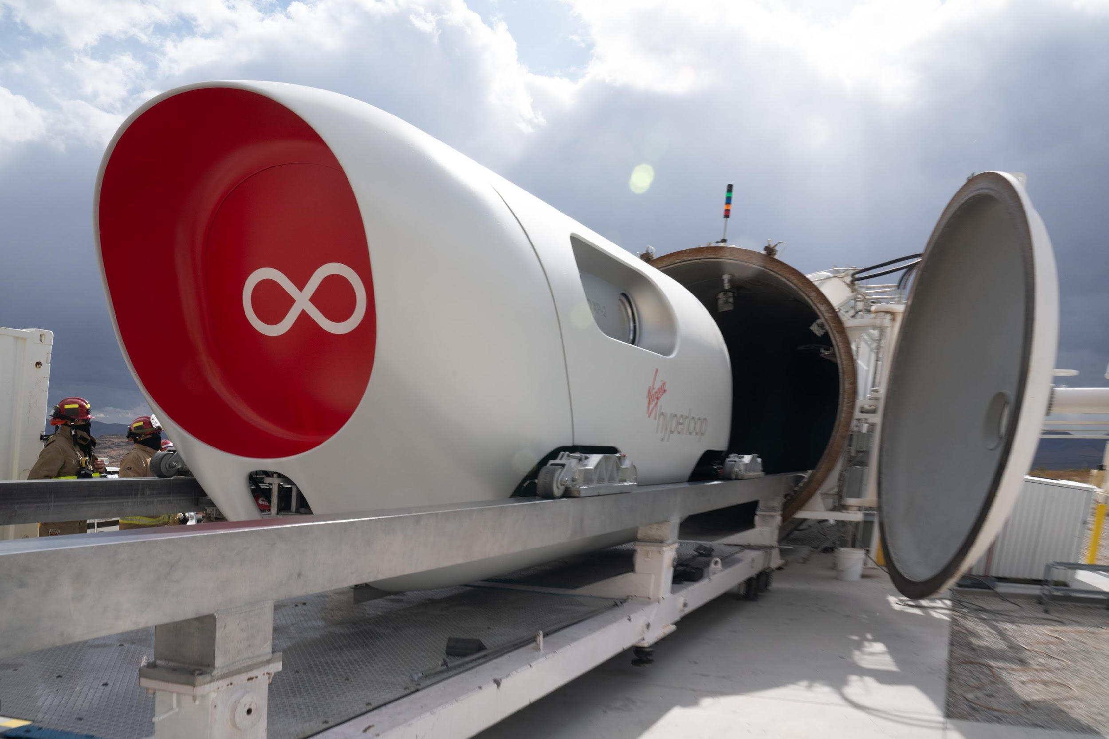
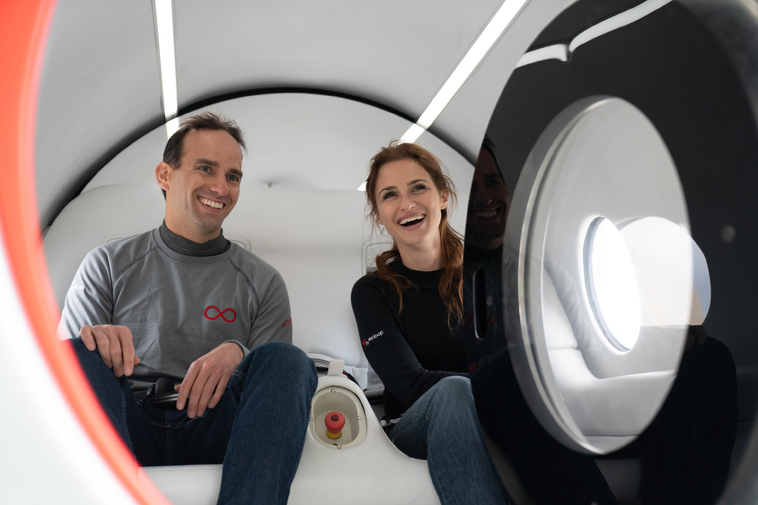
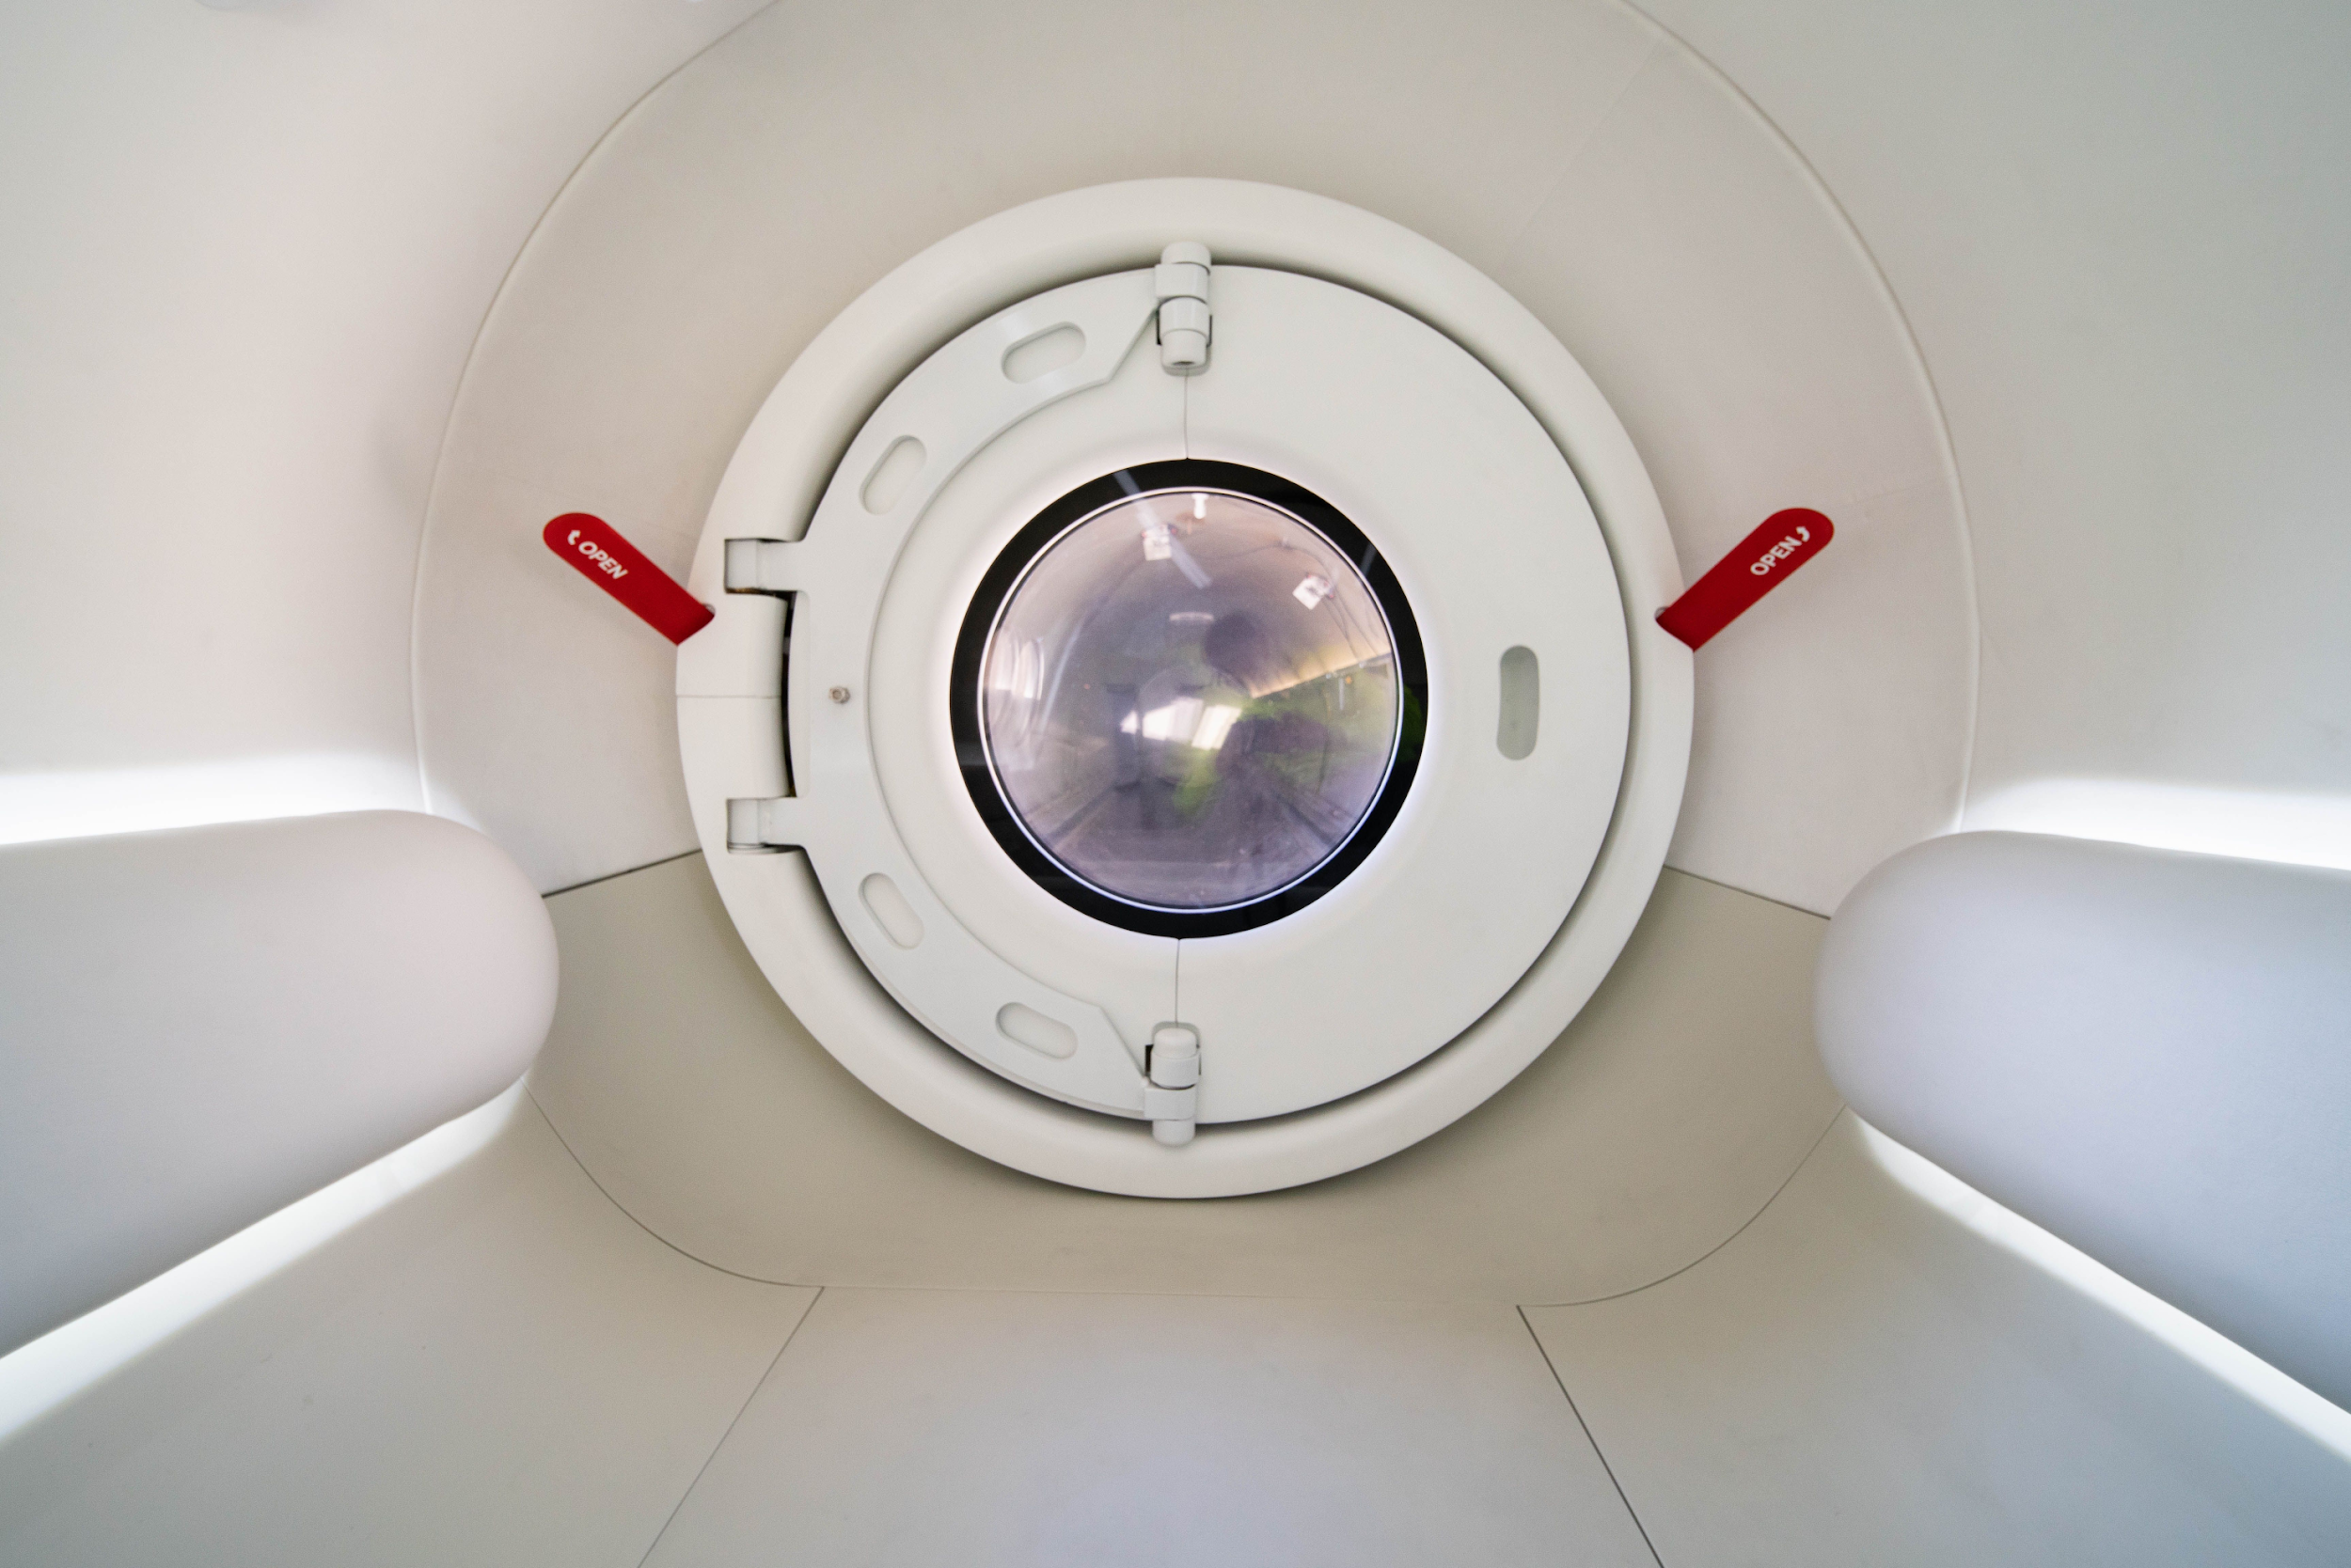
Hyperloop: bolt-on in the making
Public transportation where disabilities are an afterthought.

Slide 36
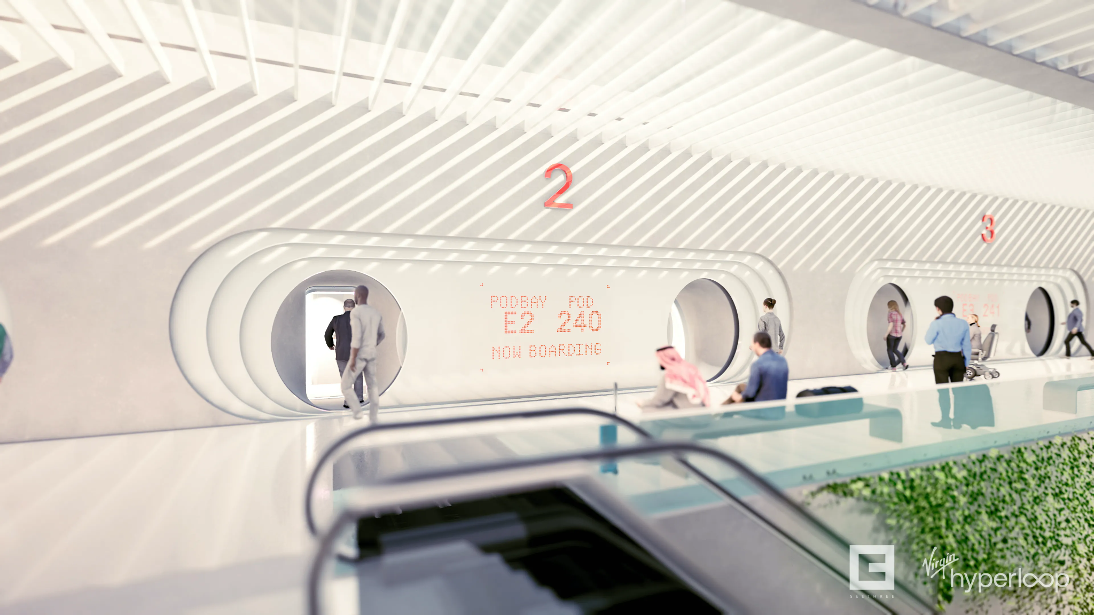

Slide 37
Takeaways
Exclusion is so pervasive we don’t see it
Even if you don’t intend to, you can marginalize people through your design and tech decisions
Accessibility should be built in from the start
Consider all the use cases

Slide 38
Breakout Activity
Facilitators take groups into virtual rooms

Slide 39
10 min Break
Stand up, stretch and drink some water!

Slide 40
Welcome back
Group discussion (15 min)
Not being recorded.
Notes:
15:05 or earlier

Slide 41
Reflection
Now that you’ve connected with your future self, how would you build experiences differently?
Notes:
Prompt 1: How has aging affected your ability to participate in daily life or in your favorite activities?
Prompt 2: How has your health and well-being changed as you've aged, and how has that affected your daily life at this future point in time?
Prompt 3: How has caring for a partner, family member (e.g. aged parent) or other-abled child (who is now adult aged) changed the dynamics of your life?
Prompt 4: How has aging affected your career? If the future point in time represents a post career period, what does that look like to you?

